Slide 1

SPEECH CLASSIFICATION WITH SNN
EE 746
Anannay Jain - 210110021
Avaneesh Sai Subramanyam - 210070015
Madhav Gupta – 21d070043

Slide 2
BACKGROUND
The Course introduced us to Image Classification tasks using SNNs on the MNIST Dataset. In this Project, We used Speech Classification using SNNs on SHD dataset. Along with weights, Delays were also trained.
SNNs capture temporal changes in speech through spikes and information in the network is also stored in delays.

Slide 3
THE SHD DATASET
The Dataset consists of 20 classes ( English and German digits)
Each input is of size 64 Timeframes and has 700 Channels.
Channels are Downscaled to 128.
Dataset Has 8156 training samples and 2264 test samples
A class (SHD2Raster) is used to preprocess the Spiking Heidelberg Dataset (SHD) for compatibility with spiking neural networks (SNN).

Slide 4
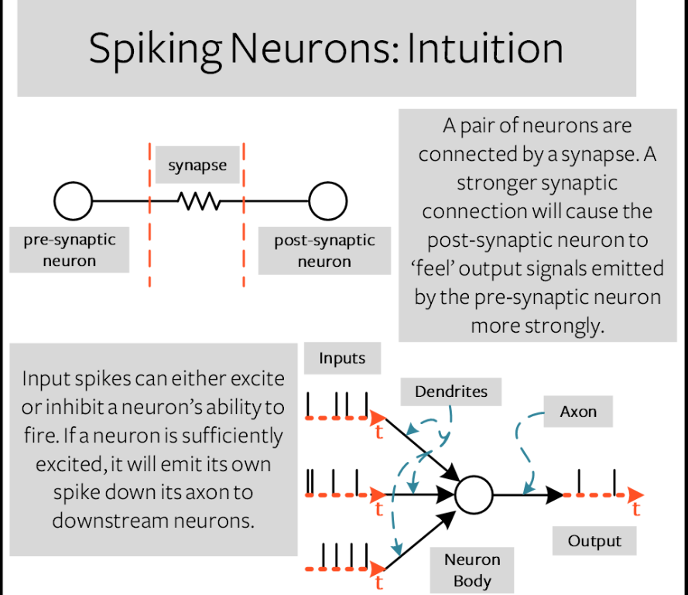
APPROACH
We have made two networks –
Basic SNN which trains just synaptic weights
SNN with Adaptive Axonal Delays
The feedforward network consists of 2 hidden layers each with 64 neurons.
The LIF neuron is used after each layer.
Batch size is 256

Slide 5
NETWORK WITH ADAPTIVE DELAYS
Hyperparameter :
Cap fraction
Maximum Delay
Sliding window Length
During Training, We change maximum delay.
If performance is improving then, we are increasing the maximum delay
Otherwise the maximum delay is decreased by one.
Delays are updated after every epoch
This requires an adaptive scheduler along with the regular network.

Slide 6
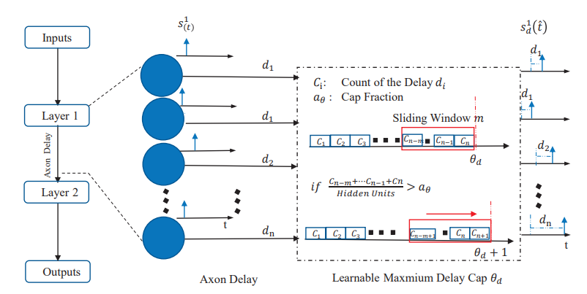
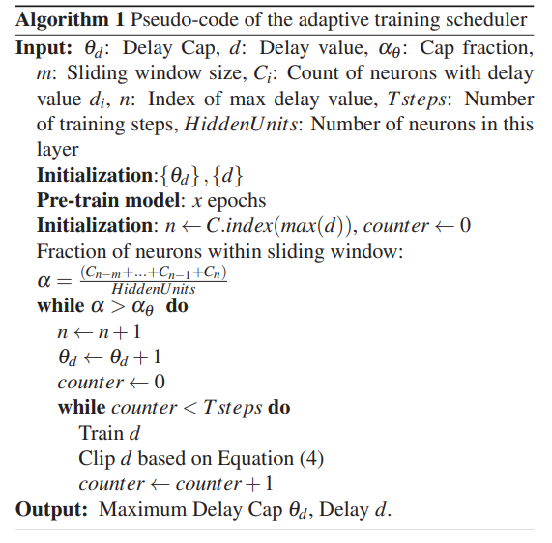
ALGORITHM OF ADAPTIVE DELAYS

Slide 7
TRAIN/TEST LOOP
BASIC NETWORK Loss Function : Cross Entropy Loss
Optimizer : ADAM
Learning Rate : 5e-4
Epochs: 50
Train time : 5 min 34 sec
Adaptive Scheduler : NO
Parameter : 13,864
Training Loss : 2.1102
Training Accuracy : 70.73%
Test Loss : 2.2486
Test Accuracy : 61.62%
ADAPTIVE NETWORK Loss Function : Cross Entropy Loss
Optimizer : ADAM
Learning Rate : 5e-4
Epochs: 50
Train time : 5 min 52 sec
Adaptive Scheduler : YES
Parameters: 13,948
Training Loss : 1.9816
Training Accuracy : 76.54%
Test Loss : 2.0273
Test Accuracy : 73.73%

Slide 8
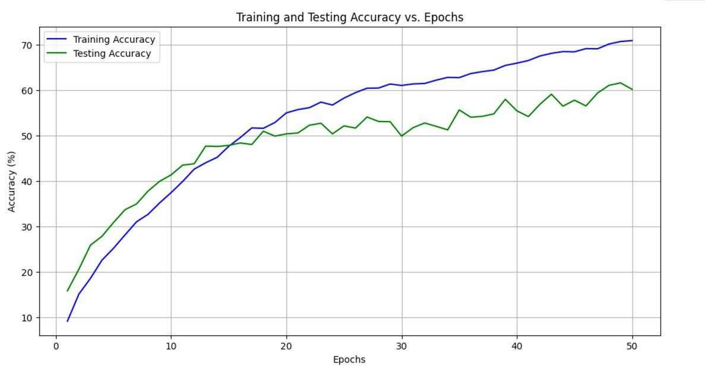
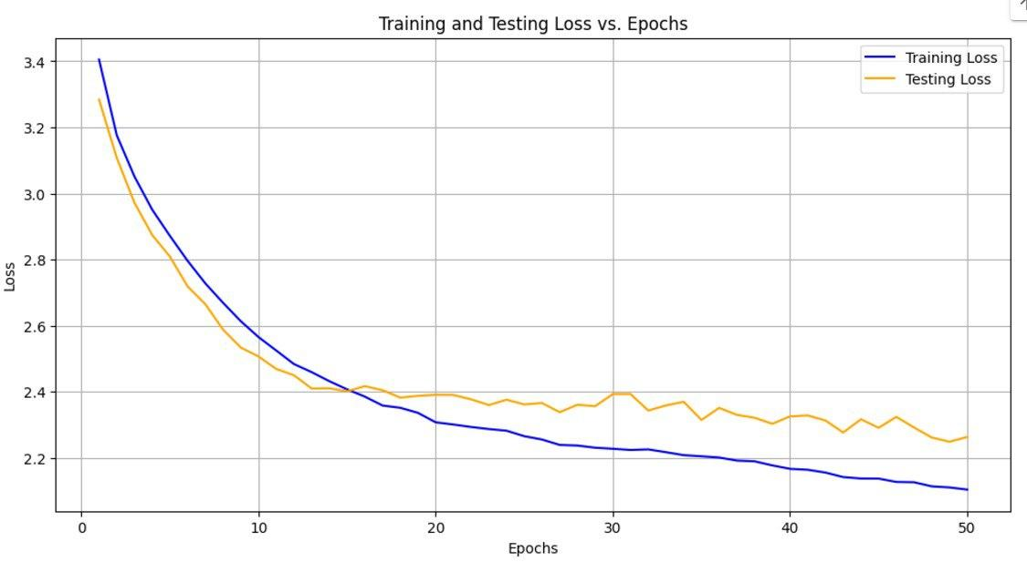
BASIC NETWORK

Slide 9
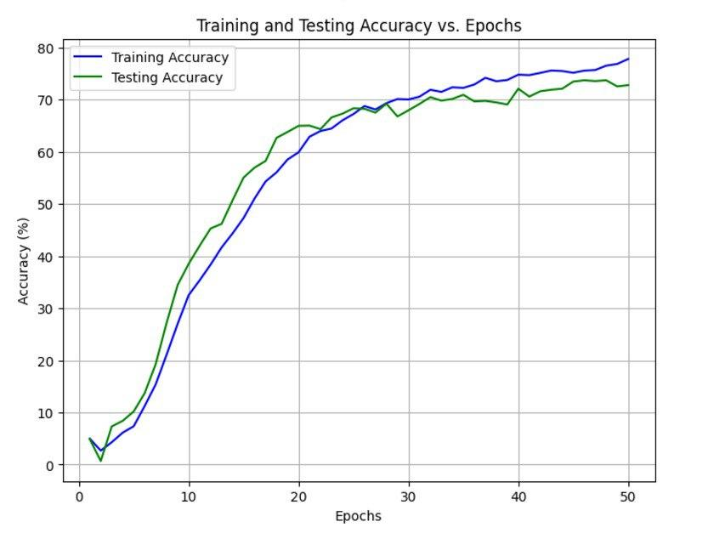
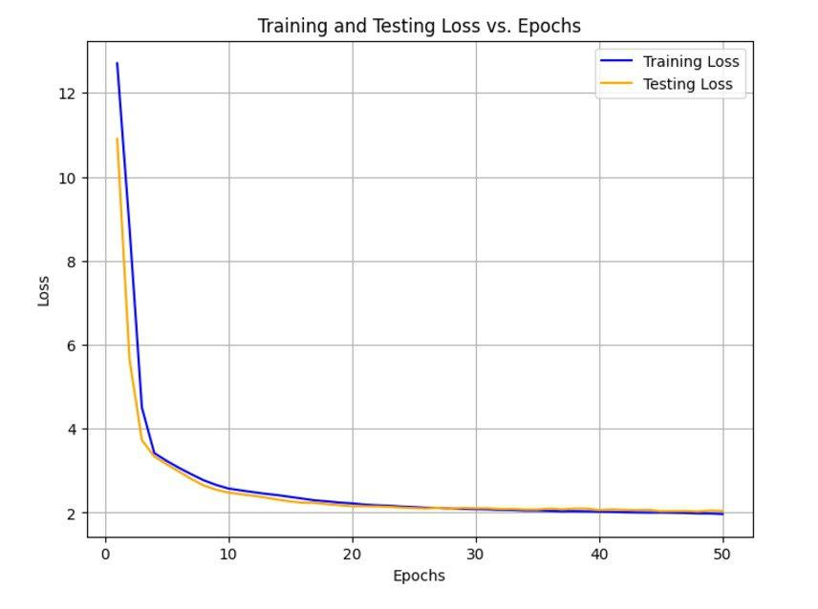
ADAPTIVE DELAY NETWORK

Slide 10
THANK YOU

